Slide 1
Fundamentals of Python:
Multithreading
MULTITHREADING, NETWORKS, AND CLIENT/SERVER PROGRAMMING

Slide 2
Threads and Processes
Time-sharing systems (late 1950s – early 1960s)
  Allowed several programs to run concurrently on a single computer
Multiprocessing systems (1980s)
  A single user running several programs at once
Networked/distributed systems (1980s –1990s)
  Processes began to be distributed across several CPUs linked by high-speed communication lines
Parallel systems
  Run a single program on several CPUs at once

Slide 3
Threads
In Python, a thread is an object like any other in that it can hold data, be run with methods, be stored in data structures, and be passed as parameters to methods
A thread can also be executed as a process
  Before it can execute, a thread’s class must implement a run method
During its lifetime, a thread can be in various states

Slide 4
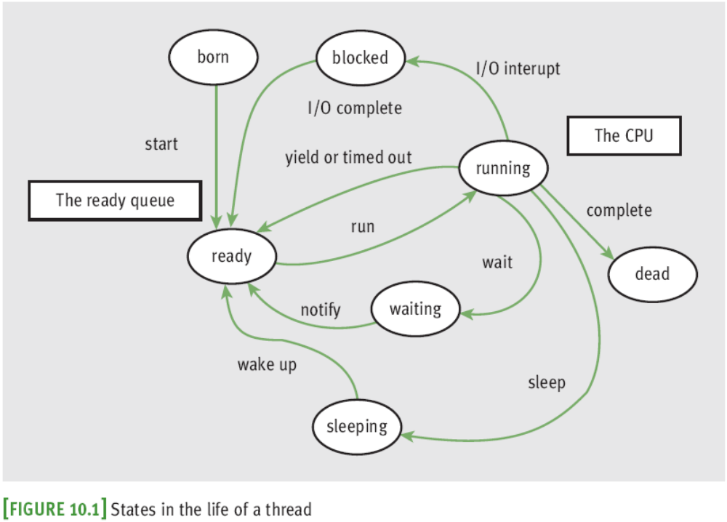
Threads (continued)

Slide 5
Threads (continued)
A thread remains inactive until start method runs
  Thread is placed in the ready queue
  Newly started thread’s run method is also activated
A thread can lose access to the CPU:
  Time-out (process also known as time slicing)
  Sleep
  Block
  Wait
Process of saving/restoring a thread’s state is called a context switch

Slide 6
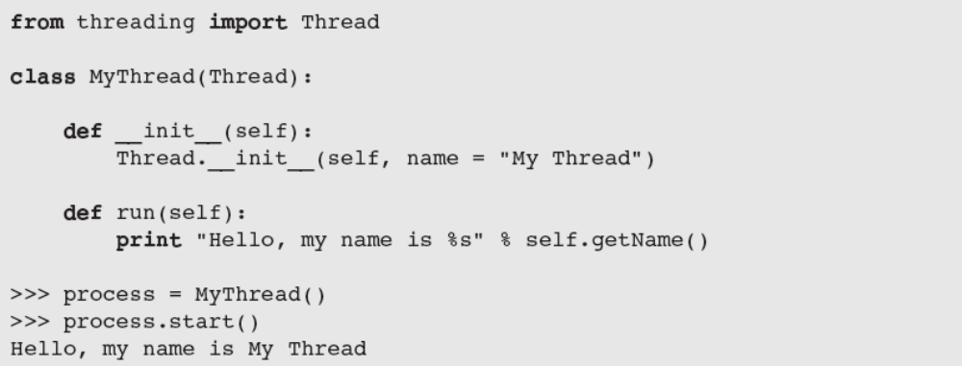
Threads (continued)
Most common way to create a thread is to define a class that extends the class threading.Thread

Slide 7
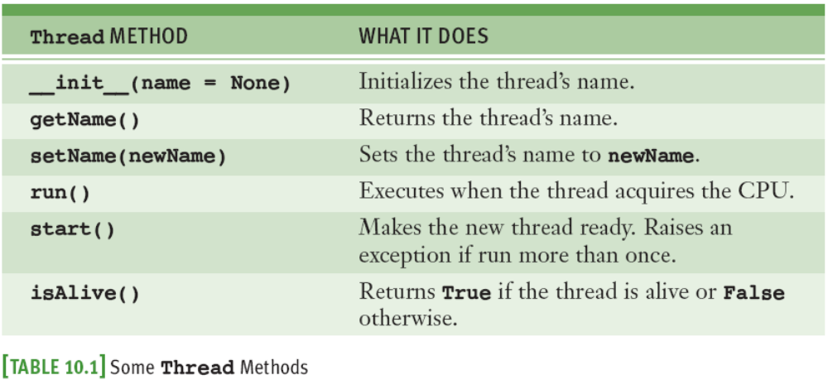
Threads (continued)
A thread’s run method is invoked automatically by start

Slide 8
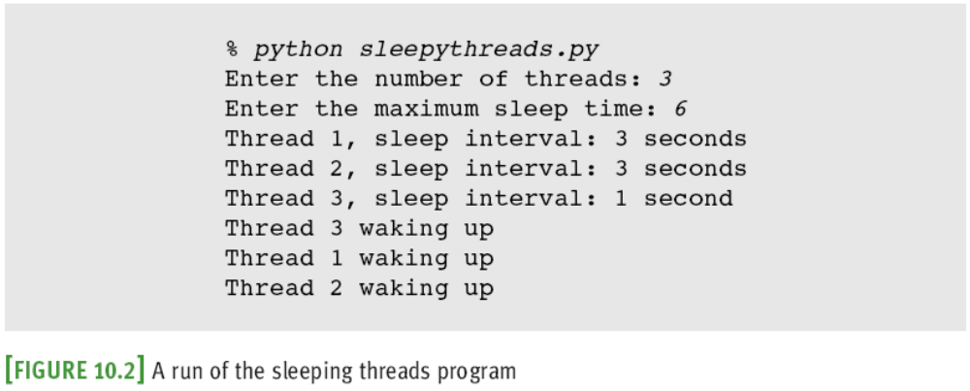
Sleeping Threads
The function time.sleep puts a thread to sleep for the specified number of seconds

Slide 9
Producer, Consumer, and Synchronization
Threads that interact by sharing data are said to have a producer/consumer relationship
Example: an assembly line in a factory
  A producer must produce each item before a consumer consumes it
  Each item must be consumed before the producer produces the next item
  A consumer must consume each item just once
We will simulate a producer/consumer relationship:
  Will share a single data cell with an integer

Slide 10
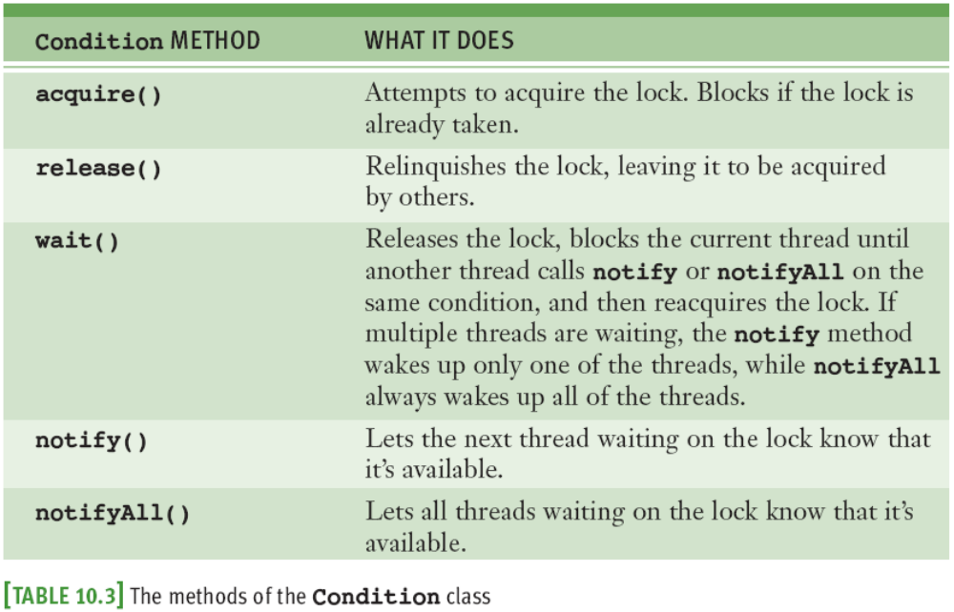
Producer, Consumer, and Synchronization

Slide 11
Networks, Clients, and Servers
Clients and servers are applications or processes that can run locally on a single computer or remotely across a network of computers
The resources required for this type of application are:
  IP addresses
  Sockets
  Threads

Slide 12
IP Addresses
A computer on a network has a unique identifier called an IP address (IP: Internet Protocol)
  Can be specified as an IP number
    Format: ddd.ddd.ddd.ddd (d is a digit)
    Example: 137.112.194.77
  Or, as an IP name
    Example: lambertk
Python’s socket module includes two functions that can look up these items of information

Slide 13
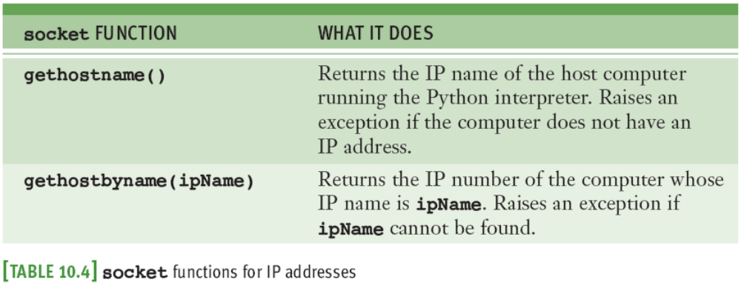
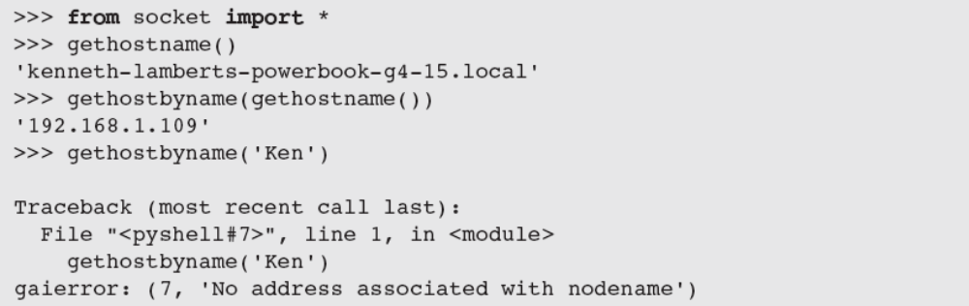
IP Addresses (continued)
May raise exceptions;
to avoid, embed in a
try-except statement
You may use ' localhost‘ (127.0.0.1) for testing

Slide 14
Ports, Servers, and Clients
Clients connect to servers via ports
  Serve as a channel through which several clients can exchange data with the same server or with different servers
  Usually specified by numbers
  Some are dedicated to special servers or tasks
    Example: 13 for the day/time server or 80 for a Web server
Most computers also have hundreds or even thousands of free ports available for use by any network applications

Slide 15
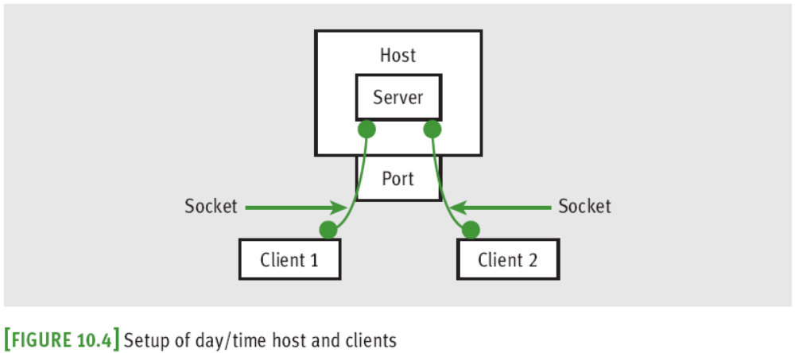
Sockets and a Day/Time Client Script
We’ll write a script that is a client to a server
Socket: object that serves as a communication link between a server process and a client process
  Can create/open several sockets on the same port
THREAD AND NETWORK

Slide 16
A Day/Time Server Script
You can write a day/time server script in Python to handle requests from many clients
The basic sequence of operations for a simple day/time server script is:
  Create a socket and open it on port 5000 of the local host
  While true:
  Wait for a connection from a client
  When the connection is made, send the date to the client

Slide 17
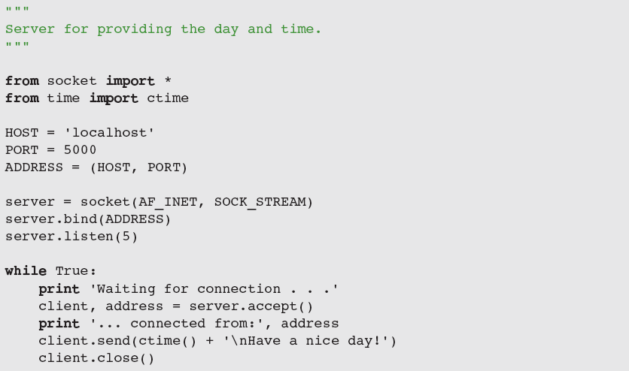
A Day/Time Server Script

Slide 18
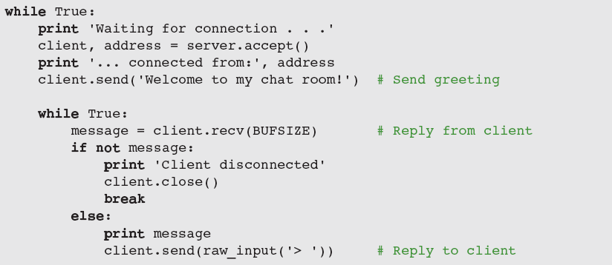
A Two-Way Chat Script
Server creates a socket and enters an infinite loop to accept/handle clients; when one connects, it sends a greeting, and enters loop to chat with client

Slide 19
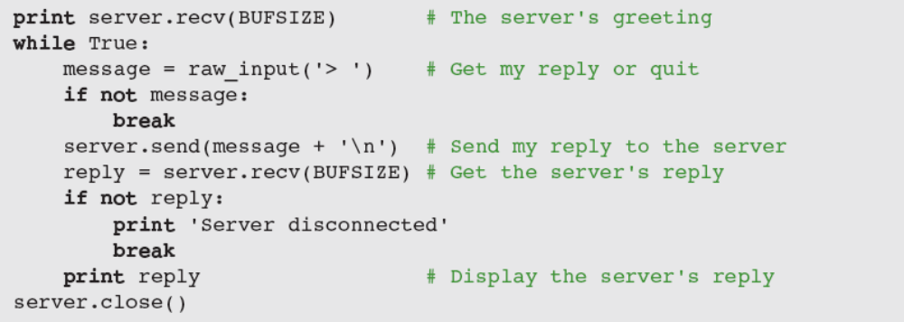
A Two-Way Chat Script (continued)
Client:
  Sets up a socket
  After connection, receives and displays greeting
  Then, enters a loop to chat with server

Slide 20
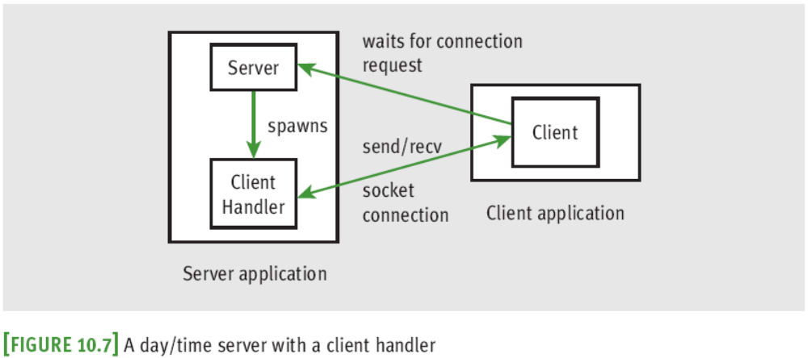
Handling Multiple Clients Concurrently
To solve the problem of giving many clients timely access to the server, we assign task of handling the client’s request a client-handler thread

Slide 21
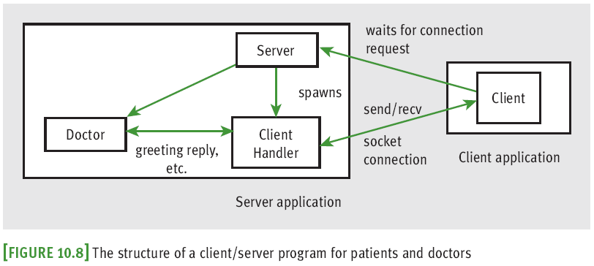
Setting Up Conversations for Others
How can we support multiple two-way chats?

Slide 22
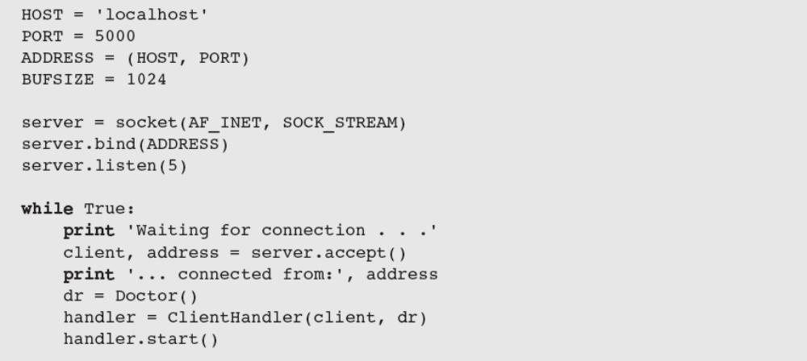
Setting Up Conversations for Others (continued)

Slide 23
Summary
Threads allow the work of a single program to be distributed among several computational processes
  States: born, ready, executing, sleeping, and waiting
After a thread is started, it goes to the end of the ready queue to be scheduled for a turn in the CPU
A thread may give up CPU when timed out, sleeps, waits on a condition, or finishes its run method
When a thread wakes up, is timed out, or is notified that it can stop waiting, it returns to the rear of the ready queue

Slide 24
Summary
Thread synchronization problems can occur when two or more threads share data
Each computer on a network has a unique IP address that allows other computers to locate it
Servers and clients can communicate on a network by means of sockets
Clients and servers communicate by sending and receiving strings through their socket connections
A server can handle several clients concurrently by assigning each client request to a separate handler thread

